Slide 1
Welcome to year 3
Mrs. Heightley, Miss Brown & Miss Navin

Slide 2
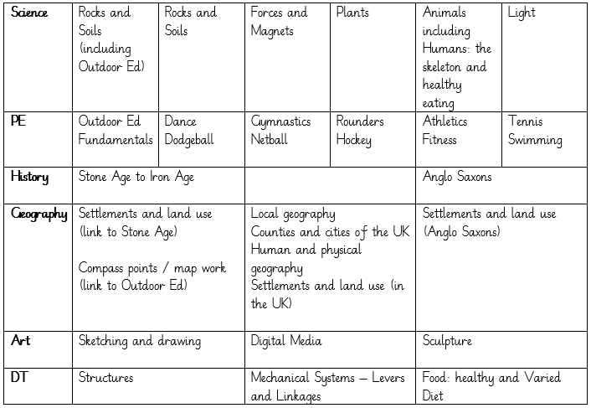
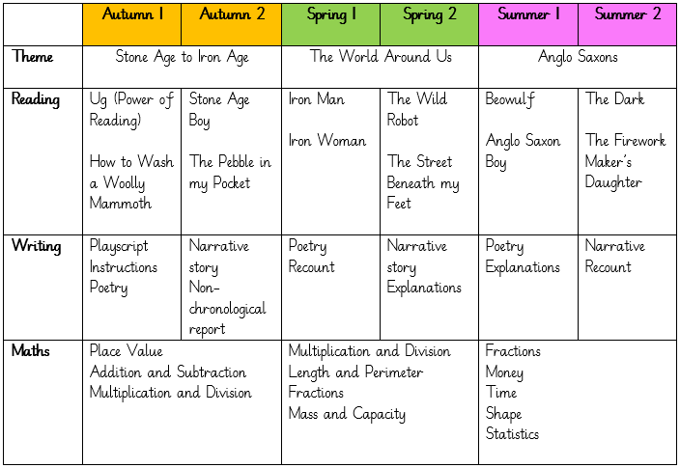
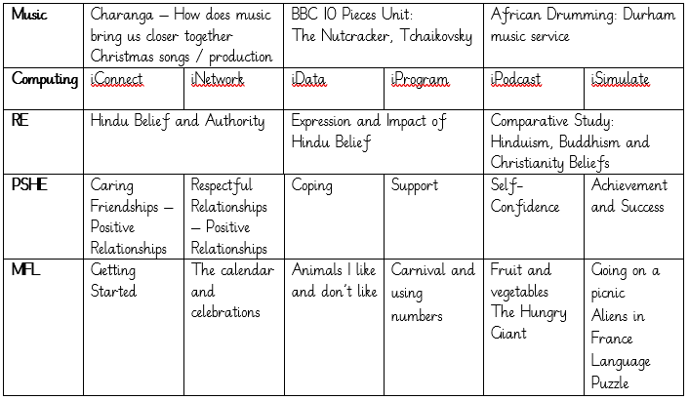
Our Learning

Slide 3
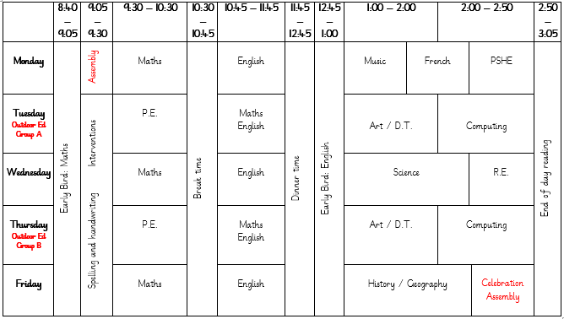
Our Learning
This is an example of a weekly timetable in Year 3. Please be aware that this is an example only as our timetable is entirely flexible and there are times when things have to be moved around to accommodate various events and activities that might be happening in school on a particular day.

Slide 4
Uniform & PE kit
PE
For the first half of the Autumn term, our PE lessons will take place on a Tuesday for those children who are on Outdoor Ed on a Thursday and on a Thursday for those children who are on Outdoor Ed on a Tuesday; please send PE kits in to school with your child on a Monday, and these will be sent home on Fridays. PE kit should consist of: tracksuit bottoms, trainers and a change of top (preferably a school t-shirt in house colours or a plain white t-shirt), as well as a sweatshirt for the outdoors.
Uniform
Children should all come to school wearing: black or grey trousers/shorts/skirt/pinafore; a white polo shirt; a blue cardigan/sweatshirt; and plain black shoes. We have thought carefully about how to keep our uniform costs manageable for families, but if there are any difficulties with providing uniform, please do let us know as we can support with this.
Free uniform is available from our Upcycling Hub – check the newsletter for further details.

Slide 5
Outdoor Education
Please ensure that for each session, your child wears:
warm clothing including hat and gloves
a warm coat
waterproofs
appropriate footwear (trainers, wellies or other suitable footwear that have a good tread)
Swimming
Year 3 will have swimming lessons during the Summer term and will need the following kit:
A swimming costume for girls (no bikinis)
Swimming shorts for boys (not board shorts and not longer than the knee)
A swimming hat (boys and girls)
A towel
Goggles (your child is welcome to wear goggles but they are not essential)
A suitable bag to carry all the kit in (preferably waterproof)
Some of our activities are water based so your child will also need:
a complete change of clothes including underwear
a towel
a pair of shoes that they don't mind getting wet

Slide 6
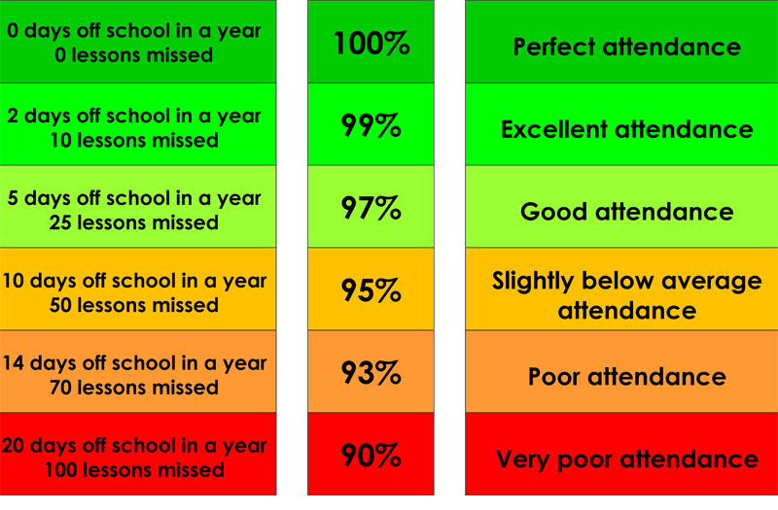
Attendance & Lateness
Every single day a child is absent = one day of learning lost
Being at school on time (Early Bird starts at 8:40 a.m.) allows your child to feel settled and prepared for their day.

Slide 7
Visits, Trips & Outdoor Education
We have lots of exciting trips and visitors planned for this year, including:
Outdoor Education (Autumn term)
Either a visit from a Stone Age woman or a visit to the Bowes Museum (Autumn term)
A proposed visit to a Mandir – a Hindu temple (Spring term)
Swimming (Summer term)
Jarrow Hall, an Anglo-Saxon farm, village and museum (Summer term)
Hardwick Park (Summer term)
We will always give you plenty of notice, especially in terms of cost/equipment, to help you plan ahead.
In addition, we will be using the local area as much as possible (such as reflection visits to St. Andrew’s Church, Spennymoor Town Library, Jubilee Park, the Cow Plantation, the Norman Cornish gallery and art trail) to extend and enrich your child’s learning.

Slide 8
Home Learning
Homework will be set through a combination of online platforms and your child’s Home Learning book. This may take different forms, but will always be set on a Monday to be completed by Friday.
Online platforms will include: Purple Mash, SumDog, Learning by Questions and Times Tables Rockstars. Children will receive individual logins for each website. I will put these into your child’s Home Learning book and we will spend time in class on each website so that we can become familiar with it.
Other homework tasks and projects may be set over the term linked to our current areas of learning.

Slide 9

Reading
We are passionate about reading in school, and believe that it is the single most important skill to give your child. It opens up the whole world to them!
Please support by hearing your child read, and signing their Reading Record, at least three times a week. and letting us know if you have any concerns.
During Year 3, we encourage and develop children’s reading fluency along with improving their vocabulary and comprehension.

Slide 10
Helping At Home
Regular reading
Times tables
Telling the time
Cooking & baking
Get outdoors
Sleep!

Slide 11
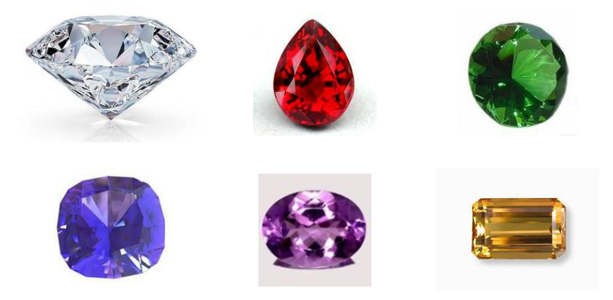
Expectations of Behaviour & Gem Powers
We have high expectations of our children, encouraging kindness, focus and self-regulation.
Visitors and members of the public always comment on the excellent behaviour of the children!
We encourage this through our Gem Powers:
Being kind
Being responsible
Being resilient
Co-operating
Collaborating
Focusing

Slide 12
Contact Information
Teachers are available each morning on the school yard for any concerns or questions.
If you would prefer to make an appointment, you can do so through the school office.
Teachers can also be contacted directly via email. Please be aware, as a school we support a healthy work-life balance and do not expect staff to respond outside of working hours so do be mindful of this!
s.wigham100@kingstreet.durham.sch.uk
j.kane103@kingstreet.durham.sch.uk
n.livesley300@kingstreet.durham.sch.uk

