Slide 1
Welcome to year 3
Mrs. Heightley, Miss Brown, Mrs. Stayman & Mr. Murdoch

Slide 2
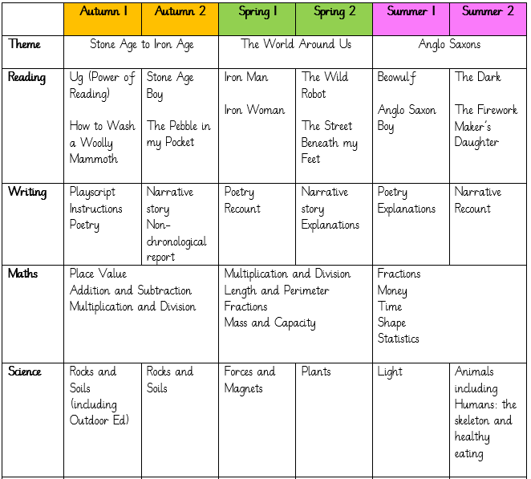
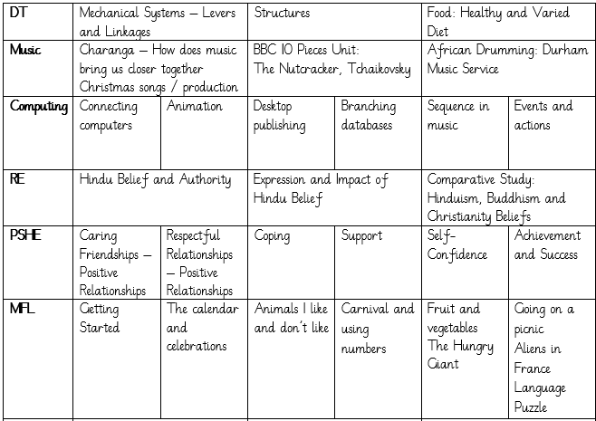
Our Learning

Slide 3
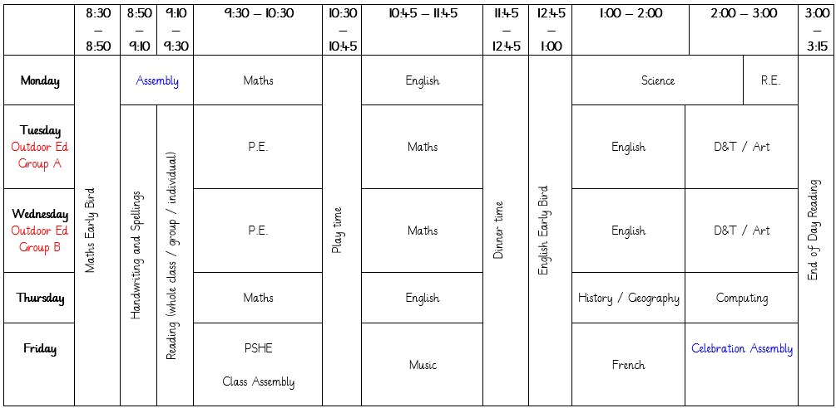
Our Learning
This is an example of a weekly timetable in Year 3. Please be aware that this is an example only as our timetable is entirely flexible and there are times when things have to be moved around to accommodate various events and activities that might be happening in school on a particular day.

Slide 4
Uniform & PE kit
PE
For the first half of the Autumn term, our PE lessons will take place on a Tuesday for those children who are on Outdoor Ed on a Wednesday and on a Wednesday for those children who are on Outdoor Ed on a Tuesday; please send PE kits in to school with your child on a Monday, and these will be sent home on Fridays. PE kit should consist of: tracksuit bottoms, trainers and a change of top (preferably a school t-shirt in house colours or a plain white t-shirt), as well as a sweatshirt for the outdoors.
Uniform
Children should all come to school wearing: black or grey trousers/shorts/skirt/pinafore; a white polo shirt; a blue cardigan/sweatshirt; and plain black shoes. We have thought carefully about how to keep our uniform costs manageable for families, but if there are any difficulties with providing uniform, please do let us know as we can support with this.

Slide 5
Outdoor Education
Please ensure that for each session, your child wears:
warm clothing including hat and gloves
a warm coat
waterproofs
appropriate footwear (trainers, wellies or other suitable footwear that have a good tread)
Swimming
Year 3 will have swimming lessons during the Summer term and will need the following kit:
A swimming costume for girls (no bikinis)
Swimming shorts for boys (not board shorts and not longer than the knee)
A swimming hat (boys and girls)
A towel
Goggles (your child is welcome to wear goggles but they are not essential)
A suitable bag to carry all the kit in (preferably waterproof)
Some of our activities are water based so your child will also need:
a complete change of clothes including underwear
a towel
a pair of shoes that they don't mind getting wet

Slide 6
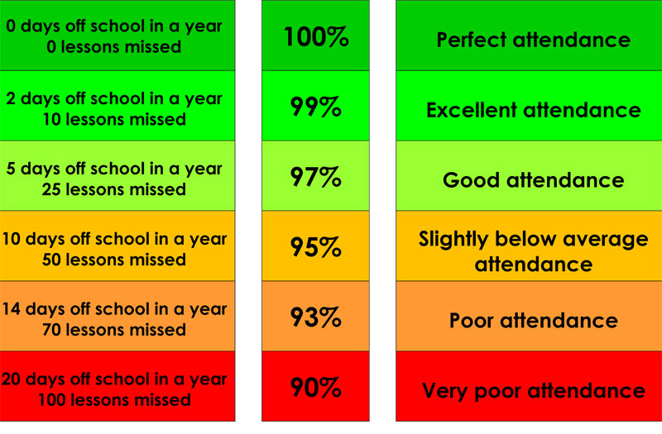
Attendance & Lateness
Every single day a child is absent = one day of learning lost
Being at school on time (Early Bird starts at 8:30 a.m.) allows your child to feel settled and prepared for their day.

Slide 7
Home Learning
Homework will be set on a Monday and is to be completed and returned to school by that Friday.
Homework will be one English activity, one Maths activity and reading.
The English activity might be spellings, a reading comprehension, or a Spelling, Punctuation and Grammar (SPaG) activity.
The Maths activity will be predominantly a times table activity (by the end of Year 3, children are expected to know their 2, 3, 4, 5, 8, 10 and 11 times tables fluently in and out of order) or linked to our classwork to consolidate work that we are completing in class.
Homework will be worksheet based and, once returned to school, will be stored in the children’s folders in class.

Slide 8
Reading
We are passionate about reading in school, and believe that it is the single most important skill to give your child. It opens up the whole world to them!
Please support by hearing your child read, and signing their Reading Record, at least three times a week. and letting us know if you have any concerns.
During Year 3, we encourage and develop children’s reading fluency along with improving their vocabulary and comprehension.

Slide 9
Other Ways to Help at Home
Regular reading
Times tables
Telling the time
Cooking & baking
Get outdoors
Sleep

Slide 10
Expectations of Behaviour & Gem Powers
We have high expectations of our children, encouraging kindness, focus and self-regulation.
Visitors and members of the public always comment on the excellent behaviour of the children!
We encourage this through our Gem Powers:
Being kind
Being responsible
Being resilient
Co-operating
Focusing
Collaborating

Slide 11
Contact Information
Teachers are available each morning on the school yard for any concerns or questions.
If you would prefer to make an appointment, you can do so through the school office.
Teachers can also be contacted directly via email. Please be aware, as a school we support a healthy work-life balance and do not expect staff to respond outside of working hours so do be mindful of this!
s.wigham100@kingstreet.durham.sch.uk
j.kane103@kingstreet.durham.sch.uk
n.livesley300@kingstreet.durham.sch.uk

