Slide 1
Welcome to year 1
Miss Boe, Mrs Gamsby & Miss Stayman

Slide 2
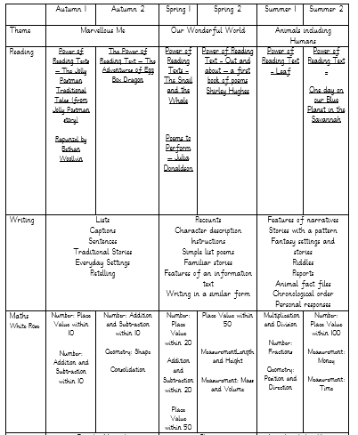
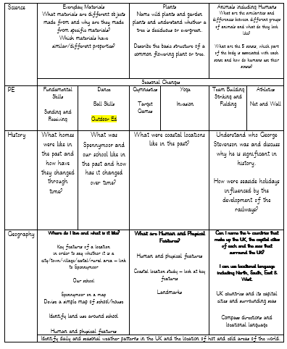
Our Learning

Slide 3
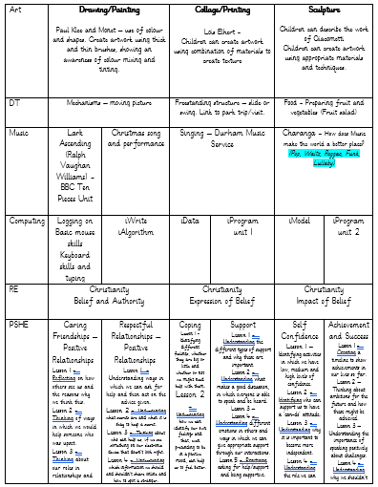
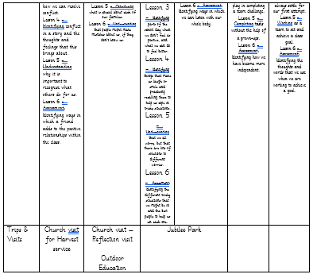
Our Learning

Slide 4
Uniform & PE kit
PE
Our PE lessons will usually take place on Tuesdays and Thursdays; please send PE kits in to school with your child on a Monday, and these will be sent home on Thursdays. PE kit should consist of: shorts, tracksuit bottoms, trainers and a change of top (preferably a school t-shirt in house colours or plain white t-shirt), as well as a sweatshirt for the outdoors. Please ensure that your child’s name is written on the labels.
Uniform
Children should all come to school wearing: black or grey trousers/shorts/skirt/pinafore; a white polo shirt; a blue cardigan/sweatshirt; and plain black shoes. Please ensure that your child’s name is written on the labels.
We have thought carefully about how to keep our uniform costs manageable for families, but if there are any difficulties with providing uniform, please do let us know as we can support with this.
Free uniform is available from our Upcycling Hub – check the newsletter for further details.

Slide 5
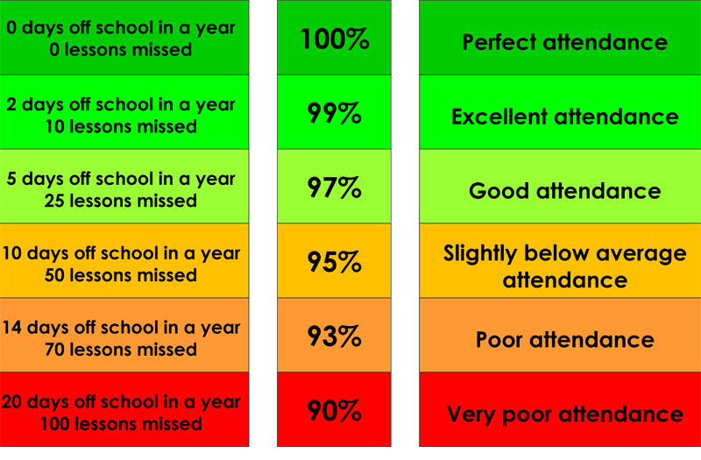
Attendance & Lateness
Every single day a child is absent = one day of learning lost
Being at school on time (Early Bird starts at 8.40am) allows your child to feel settled and prepared for their day.

Slide 6
Visits, Trips & Outdoor Education
We have lots of trips and visitors planned for this year, including:
Spennymoor Post Office (Autumn Term)
St Andrew’s Church – Harvest Service (Autumn term)
Outdoor Education – after October half term. Further information to follow.
Botanical Gardens, Durham (Spring Term)
Jubilee Park (Spring Term)
We will always give you plenty of notice, especially in terms of cost/equipment, to help you plan ahead.
In addition, we will be using the local area as much as possible (such as reflection visits to St. Andrew’s Church, Spennymoor Town Library) to extend and enrich your child’s learning.

Slide 7
Home Learning
Homework will be set through a combination of online platforms and your child’s Home Learning book. This may take different forms, but will always be set on a Monday to be completed by Friday. If you are unable to access online activities please let us know.
Children will shortly be given individual log ins for Purple Mash, Bug Club Phonics and Numbots. Please look out for these in their home learning book.
Other homework tasks may be set over the term linked to our current areas of learning.

Slide 8

Reading
We are passionate about reading in school, and believe that it is the single most important skill to give your child. It opens up the whole world to them!
Please support by hearing your child read at least three times a week, and letting us know if you have any concerns.

Slide 9
Helping At Home
Regular reading
Telling the time
Cooking & baking
Get outdoors
Sleep!

Slide 10
Year 1 Phonics Check
This takes place in June.
The children will use their knowledge of letter sounds to blend and read real and nonsense words.
We will do lots of work around phonics this year, but please support us at home with lots of regular reading.
Phonics Meeting will be held on Thursday 29th September at 4.00pm

Slide 11
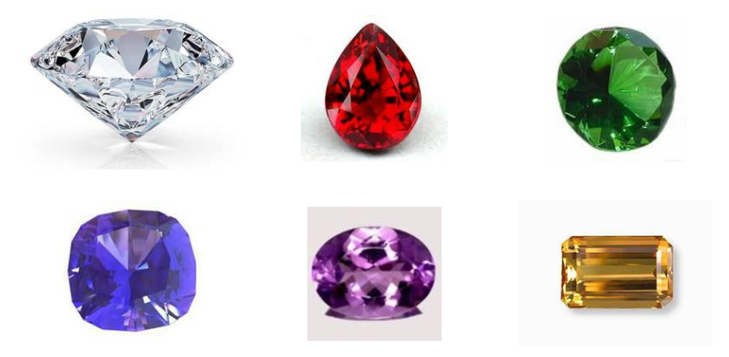
Expectations of Behaviour & Gem Powers
We have high expectations of our children, encouraging kindness, focus and self-regulation.
Visitors and members of the public always comment on the excellent behaviour of the children!
We encourage this through our Gem Powers:
Being kind
Being responsible
Being resilient
Co-operating
Collaborating
Focusing

Slide 12
Contact Information
Teachers are available each morning on the school yard for any concerns or questions.
If you would prefer to make an appointment, you can do so through the school office.
Teachers can also be contacted directly via email. Please be aware, as a school we support a healthy work-life balance and do not expect staff to respond outside of working hours so do be mindful of this!
J.Boe244@kingstreet.durham.sch.uk

Slide 13
Further Contact Information
j.kane103@kingstreet.durham.sch.uk
SENDCO
n.livesley300@kingstreet.durham.sch.uk
Pastoral Support & SEMH

Slide 14
Any questions?

