Slide 1
Phonics and Reading in Reception

Slide 2
Early Learning Goal for Reading
Say a sound for each letter in the alphabet and at least 10 digraphs ( 2 letters making 1 sound e.g. oo ee ai)
Read words consistent with their phonic knowledge by sound-blending.
Read aloud simple sentences and books that are consistent with their phonic knowledge, including some common exception words.

Slide 3
Bug Club Phonics
Phase 1 – developing pre-reading skills (started in Nursery)
Phase 2 – s, a, t, p, i, n, m, d, g, o, c, k, ck, e, u, r, h, b, f, ff, l, ll,ss
Phase 3 – j, v, w, x, y, z, zz, qu, ch, sh, th, ng, ai, ee, igh, oa, oo (long), oo (short), ar, or, ur, ow, oi, ear, air, ure, er
Phase 4 – uses all phonemes from phase 2 and 3 in longer words where it starts and / or ends with 2 consonants
e.g. Gran, beach, stamp

Slide 4
Pure Sounds
Oxford Owl video
https://www.youtube.com/watch?v=UCI2mu7URBc
Bug Club https://www.activelearnprimary.co.uk/planning#bugclub_phonics

Slide 5
Terminology
Phoneme – the smallest unit of sound in a word
Grapheme – written letters that represent the phoneme (sound)
Digraph – 2 letters making 1 sound e.g. ai, ee, oo
Trigraph – 3 letters making 1 sound e.g. igh, air, ear
Blending – blend the phonemes (sounds) together when reading
Segmenting – split the word into phonemes (sounds) when spelling

Slide 6
Tricky Words
Phase 2 – to, the, no, go, I, into, her
Phase 3 – me, be, he, my, by, she, they, we, are, you, all, was, give, live
Children need to recognise these as a whole word.

Slide 7
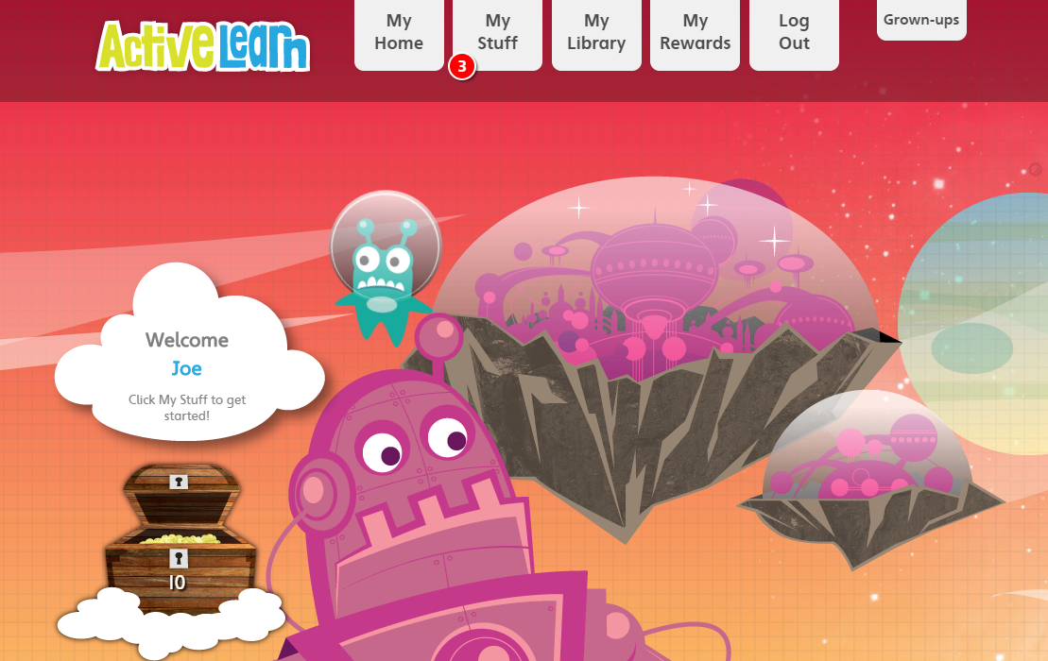
Bug Club online

Slide 8
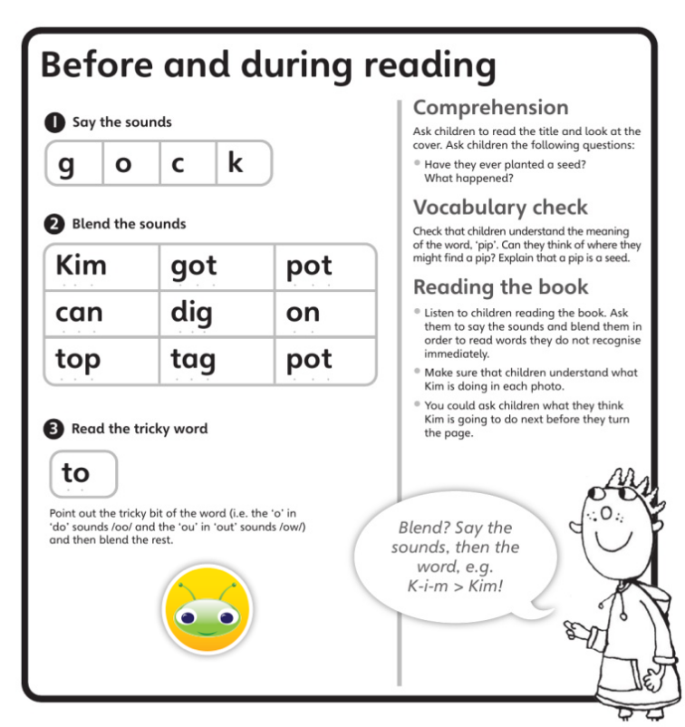
Reading books
Changed once a week
Please re-read the book throughout the week to develop their fluency (pace of their reading)
Children need to bring their reading book into school every day
You don’t need to read the full book in one night
If struggling, try reading a page each or a word each. Then re-read the page together.
Ask questions about what’s happened in the book and what they liked/disliked about it

Slide 9
Ways to support your child at home
Bug Club online – games, activities and reading books
Making words with fridge magnets
Sound talking e.g. ‘Can you pass me the p-e-n please?’
I spy with my little eye, something that sounds like s-u-n
Simon says put your hands on your h-ea-d
Teach your monster to read app / website
Phonics Play website
Mr Thorne Does Phonics videos on You Tube

